Slide 1
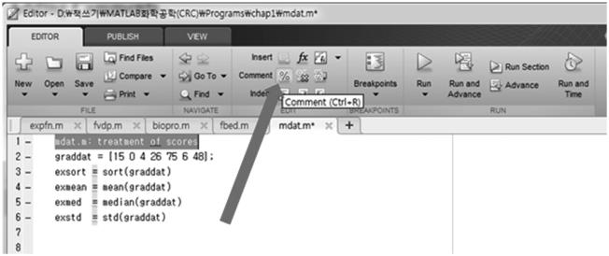
20
Chemical Engineering Computation with MATLAB®
entering scex1 in the Command Window. The output will be displayed in the Command Window.
The M-ﬁle can easily be modiﬁed. For example, if you wish to calculate sin(0.02)/0.02, you can
modify the M-ﬁle as follows:
format long
x = [1.5 0.4 0.06 0.02];
y = sin(x)./x
Suppose that you want to treat results of examinations with MATLAB functions such as sort,
mean, median, and std. In the MATLAB editor, type the following commands into an M-ﬁle and
save this ﬁle with the name mdat.m:
graddat = [15 0 4 26 75 6 48];
exsort = sort(graddat)
exmean = mean(graddat)
exmed = median(graddat)
exstd = std(graddat)
You can run this script by entering mdat in the Command Window:
>> mdat
exsort =
Trail Version
Trail Version
Trail Version
Trail Version
Trail Version
Trail Version
Trail Version
Trail Version
Trail Version
Trail Version
Trail Version
Trail Version
Trail Version
0
4
6
15
26
48
75
exmean =
24.8571
exmed =
15
exstd =
27.5586
1.7.2 adding CommEnts
A comment is an explanatory line for the reader that is ignored by MATLAB when the script is exe-
cuted. To put in a comment, simply type the % character at the beginning of a line or select the com-
ment lines and then click on the % symbol on the desktop “EDITOR” tab as shown in Figureꢀ1.7.
Inꢀthe MATLAB editor, the comments will be displayed in green.
FIGURE 1.7 Adding comments.

Slide 2
Introduction to MATLAB®
21
The following script is a modiﬁed scex1.mﬁle with new comments:
format long
% 14 decimal digits
x = [1.5 0.4 0.06 0.02];
y = sin(x)./x
% the value of y=sin(x)/x approaches to 1
% as x approaches to zero.
Longer comments, called comment blocks, consist of everything in between %{ and %}, which
must be alone on separate lines. For example:
format long
% 14 decimal digits
x = [1.5 0.4 0.06 0.02];
y = sin(x)./x
%{
Example of comment block: this is long comments
the value of y=sin(x)/x approaches to 1
as x approaches to zero.
%}
1.7.3 funCtion m-filEs
Function M-ﬁles, unlike script M-ﬁles, allow you to specify input values when you run them from
the MATLAB command line or from another M-ﬁle. Like a script M-ﬁle, a function M-ﬁle is a plain
text ﬁle that should reside in your current directory or elsewhere in your MATLAB path.
As an example, let’s create a function M-ﬁle that calculates some values of sin(x)/x with x = 10^{–a}
for several values of a. Here is a function M-ﬁle called sinxdesigned to execute these calculations;
this ﬁle is stored in a ﬁle called sinx.m.
Trail Version
Trail Version
Trail Version
Trail Version
Trail Version
Trail Version
Trail Version
Trail Version
Trail Version
Trail Version
Trail Version
Trail Version
Trail Version
function y = sinx(z)
% SINX calculates sin(x)/x for x = 10^(-a),
% where a = 1, ..., z.
format long
a = 1:z;
x = 10.^(-a);
y = (sin(x)./x)';
end
The ﬁrst line of the ﬁle starts with function, which identiﬁes the ﬁle as a function M-ﬁle. The
Editor colors this special word blue. The ﬁrst line of the M-ﬁle speciﬁes the name of the function
and describes both input arguments (or parameters) and output values. In this example, the function
is called sinx. The ﬁle name without the .m extension and the function name should match. It is
good practice to follow the ﬁrst line of a function M-ﬁle with one or more comment lines explain-
ing what the M-ﬁle does. If you do, help will automatically retrieve this information. For example:
>> help sinx
sinx calculates sin(x)/x for x = 10^(-a),
where a = 1, ..., z.
The following is an example of a call to this function in which z is set to 3 and the value returned is
stored in the default variable ans:
>> sinx(3)
ans =

Slide 3
22
Chemical Engineering Computation with MATLAB®
0.998334166468282
0.999983333416666
0.999999833333342
1.8 FUNCTIONS
MATLAB contains a wide variety of built-in functions. However, you will often ﬁnd it useful to
create your own MATLAB functions.
1.8.1 Built-in funCtions
MATLAB has many built-in functions such as sqrt, cos, sin, tan, log, exp, atan, gamma,
erf, and besselj. The function logis the natural logarithm that is written as “ln.” The base 10
logarithm is represented by the function log10in MATLAB. For example:
>> log(exp(5))
ans =
5
>> log10(exp(5))
ans =
2.1715
>> sin(2*pi/5)
ans =
Trail Version
Trail Version
Trail Version
Trail Version
Trail Version
Trail Version
Trail Version
Trail Version
Trail Version
Trail Version
Trail Version
Trail Version
Trail Version
0.9511
Symbolic representation can also be used:
>> sin(sym('2*pi/5'))
ans =
(2^(1/2)*(5^(1/2) + 5)^(1/2))/4
MATLAB also contains many linear algebra functions. Consider a system of linear equations
given by
-x -3x = -2
1
3
5x + 2x -6x = 1
1
2
3
-4x + x +8x = 3
1
2
3
Now let
é-1
0
2
1
-3ù
éx ù
é-2ù
ê
ú
1
ê
ú
ú
ê
ê
ú
ú
A =
5
ê
-6 , x = x
,
b =
1
3
ú
ê
ê-
ú
û
2
ë
4
8
êx ú
ê
ë
ú
û
ë û
3
Then the linear system can be expressed as
Ax = b

Slide 4
Introduction to MATLAB®
23
The solution to this system can be obtained by using the backslash function (\):
>> A = [-1 0 -3; 5 2 -6; -4 1 8]
A =
-1
5
-4
0
2
1
-3
-6
8
>> b = [-2; 1; 3]
b =
-2
1
3
>> x = A\b
x =
0.4754
0.8361
0.5082
1.8.2 usEr-dEfinEd funCtions
There are three ways to create functions:
1. Use the inlinecommand.
2. Create an anonymous function using the @operator.
3. Create in a separate M-ﬁle.
Trail Version
Trail Version
Trail Version
Trail Version
Trail Version
Trail Version
Trail Version
Trail Version
Trail Version
Trail Version
Trail Version
Trail Version
Trail Version
Anonymous or inline functions are most useful for deﬁning simple functions that can be expressed
in one line and for turning the output of a symbolic command into a function. Function M-ﬁles are
useful for deﬁning functions that require several intermediate commands to compute the output.
Aꢀseparate M-ﬁle can be created by using the MATLAB editor as mentioned before. As an example,
let’s deﬁne the function f(x)=x³. We can use the inlinecommand:
>> fl = inline('x^3', 'x')
fl =
Inline function:
f1(x) = x^3
or we can use the @ operator to deﬁne f(x) as an anonymous function:
>> f = @(x) x^3
f =
function_handle with value:
@(x)x^3
Once the function is created, we can use it by providing the input value:
>> f1(5)
ans =
125
>> f(5)
ans =
125

Slide 5
24
Chemical Engineering Computation with MATLAB®
Vectors and matrices can also be used as input arguments. Thus, it is a good practice to put a dot
symbol (.) right before the mathematical operators such as *, /, and ^. The function f(x)=x³ can be
redeﬁned using the dot symbol as
>> f = @(x) x.^3
f =
function_handle with value:
@(x)x.^3
or
>> f1 = inline('x.^3', 'x')
f1 =
Inline function:
f1(x) = x.^3
The function deﬁned in this manner can accept a vector as an input argument. For example:
>> f(2:8)
ans =
8
27
64 125 216 343 512
We can also deﬁne a function of more than two independent variables. For example:
Trail Version
Trail Version
Trail Version
Trail Version
Trail Version
Trail Version
Trail Version
Trail Version
Trail Version
Trail Version
Trail Version
Trail Version
Trail Version
>> g = @(x, y) x^3 + y^2; g(1,2)
>> g1 = inline('x^3 + y^2', 'x', 'y'); g1(1,2)
If we want to allow vector–matrix operations in the function, we can deﬁne the function g(x) as
>> g = @(x, y) x.^3 + y.^2;
For example, we can get function values at two points:
>> g([1 2], [3 4])
ans =
10
24
1.9 LOOPS
MATLAB has four ﬂow control structures: the ifstatement, the forloop, the whileloop, and
the switchstatement.
1.9.1 ifstatEmEnt
The simplest form of the ifstatement is
if (expression)
(statements)
end
where the statementsare executed if the elements of expressionare all nonzero. For exam-
ple, the following code swaps x and y if x is greater than y:
if x > y
temp = y;

Slide 6
Introduction to MATLAB®
25
y = x;
x = temp;
end
One or more further tests can be added with elseif. There must be no space between else and if.
1.9.2 forloop
The basic form of the forloop is
for (variable) = (expression)
(statements)
end
For example, the sum of the ﬁrst 25 terms of the harmonic series 1/i is calculated by
>> s = 0;
>> for i = 1:25, s = s + 1/i; end, s
s =
3.8160
Multiple forloops can be nested. The expressionin the forloop can be a matrix, in which
case variableis assigned the columns of expressionfrom ﬁrst to last.
The whileloop has the form
Trail Version
Trail Version
Trail Version
Trail Version
Trail Version
Trail Version
Trail Version
Trail Version
Trail Version
Trail Version
Trail Version
Trail Version
Trail Version
while (expression)
(statements)
end
The statementsare executed as long as the expressionis true.
1.10 GRAPHICS
1.10.1 plotting With ezplot
The simplest way to graph a function of one variable is with ezplot. The ezplot function
expects a string, a symbolic expression, or an anonymous function, representing the function to be
plotted. For example, to plot x³ −4x+3 on the interval –3 to 3 using the string form of ezplot, enter
>> ezplot('x^3 - 4*x + 3', [-3 3])
The plot will appear on the screen in a new window labeled “Figure 1.” Using a symbolic expres-
sion, you can produce the plot in Figure 1.8 with the following input:
>> syms x, ezplot('x^3 - 4*x + 3', [-3 3])
An anonymous function can also be used as the argument to ezplotas
>> ezplot(@(x) x.^3 - 4*x + 3, [-3 3])
1.10.2 modifying graphs
A graph can be modiﬁed in a number of ways. You can change the title above the graph in Figure 1.8
by typing in the Command Window:
>> title 'Plot of a 3rd-order polynomial'

Slide 7
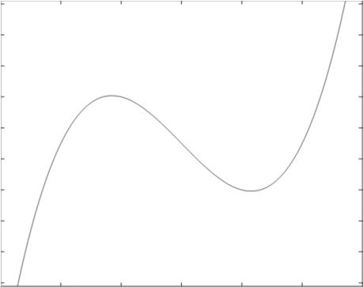
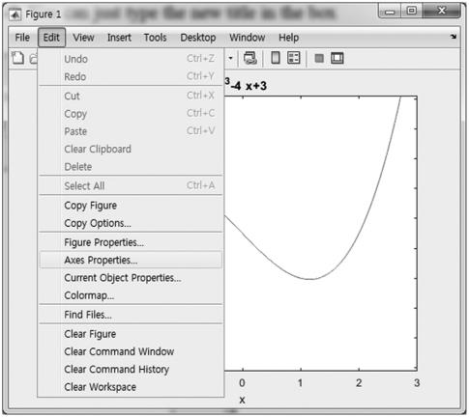
26
Chemical Engineering Computation with MATLAB®
12
10
8
x³ –4x+ 3
6
4
2
0
–2
–4
–6
–3
–2
–1
0
x
1
2
3
FIGURE 1.8 Plot of x³ −4x+3 on the interval [−3, 3].
The same change can be made directly in the ﬁgure window by selecting Axes Properties… from
the Edit menu at the top of the ﬁgure window, as shown in Figure 1.9. You can just type the new title
in the box marked “Title.”
You can add a label on the vertical axis with ylabelor change the label on the horizontal axis
with xlabel. Also, you can change the horizontal and vertical ranges of the graph with the axis
command. For example, to conﬁne horizontal range to the interval from –2 to 2 and the vertical
range to the interval from –2 to 8, type
Trail Version
Trail Version
Trail Version
Trail Version
Trail Version
Trail Version
Trail Version
Trail Version
Trail Version
Trail Version
Trail Version
Trail Version
Trail Version
>> axis ([-2 2 -2 8])
FIGURE 1.9 Edit menu of the ﬁgure window.

Slide 8
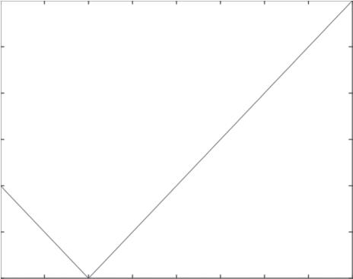
Introduction to MATLAB®
27
The ﬁrst two numbers are the range of the horizontal axis, and the last two numbers are the range of
the vertical axis. Both ranges must be included even if only one is changed. To make the shape of
the graph square, type axis square. This command also makes the scale the same on both axes
if the x and y ranges have equal length. For ranges of any lengths, you can force the same scale on
both axes without changing the shape by typing axis equal.
1.10.3 graphing With plot
The plotfunction works on vectors of numerical data. The basic syntax is plot(X,Y), where X
and Y are vectors of the same length. For example:
>> X = [1 2 5]; Y = [4 2 8]; plot(X,Y)
The plot function considers the vectors X and Y to be lists of the x and y coordinates of successive
points on a graph and connects the points with line segments. So, in Figure 1.10, MATLAB connects
(1,4) to (2,2) to (5,8).
In general, the plot function generates a two-dimensional (2D) graph:
>> t = 0:0.002:1; z = exp(9.8*t.*(t-1)).*sin(10*pi*t);
>> plot(t,z)
where plot(t,z)uses a basic solid line to join the points t(i) with z(i) to create the curve shown
in Figure 1.11. The ﬁgure window can be closed by typing closeat the prompt.
To plot x³ −4x+3 on the interval [−2, 2], we specify the range of the independent variable x,
compute y=x³ −4x+3, and then plot the results. The function gridintroduces a light horizontal
and vertical hashing that extends from the axis ticks. The following code produces the plot shown
in Figure 1.12.
Trail Version
Trail Version
Trail Version
Trail Version
Trail Version
Trail Version
Trail Version
Trail Version
Trail Version
Trail Version
Trail Version
Trail Version
Trail Version
>> x = -2:0.1:2;
>> y = x.^3 -4*x +3;
>> plot(x,y)
>> grid
>> title('x^3 -4*x +3')
>> xlabel('x'), ylabel('y')
8
7
6
5
4
3
2
1
1.5
2
2.5
3
3.5
4
4.5
5
FIGURE 1.10 Plot of line segments.

Slide 9
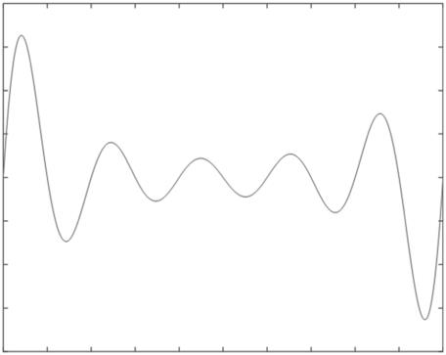
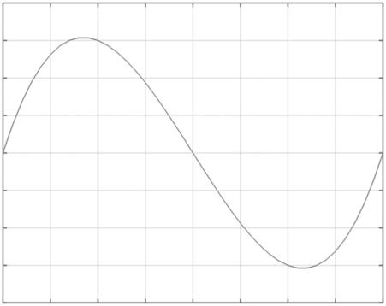
28
Chemical Engineering Computation with MATLAB®
0.8
0.6
0.4
0.2
0
–0.2
–0.4
–0.6
–0.8
0
0.1
0.2
0.3
0.4
0.5
0.6
0.7
0.8
0.9
1
FIGURE 1.11 2D graph by plot function.
7
6
x³– 4x+ 3
Trail Version
Trail Version
Trail Version
Trail Version
Trail Version
Trail Version
Trail Version
Trail Version
Trail Version
Trail Version
Trail Version
Trail Version
Trail Version
5
4
3
2
1
0
–1
–2
–1.5
–1
–0.5
0
x
0.5
1
1.5
2
FIGURE 1.12 Graph of x³ −4x+3 on the interval [−2, 2].
1.10.4 plotting multiplE CurVEs
Each time you execute a plotting command, MATLAB erases the old plot and draws a new one. If
you want to overlay two or more plots, use hold on. This command instructs MATLAB to retain
the old graphics and draw any new graphics on top of the old ones. It remains in effect until you
type hold off. Do not forget to enter hold offafter graphing whenever you use hold on.
The following is an example using the ezplotfunction to create the plot shown in Figure 1.13:
>> ezplot('exp(-x^1.2)', [0 6])
>> hold on

Slide 10
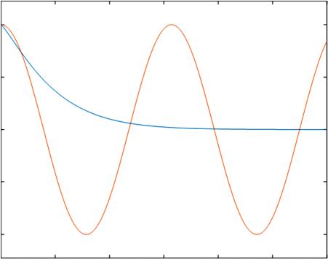
Introduction to MATLAB®
29
exp(–x^{1.2}) and cos(2*x)
1
0.5
0
–0.5
–1
0
1
2
3
4
5
6
x
FIGURE 1.13 Plots of e^{-x1.2} and cos(2x).
Trail Version
Trail Version
Trail Version
Trail Version
Trail Version
Trail Version
Trail Version
Trail Version
Trail Version
Trail Version
Trail Version
Trail Version
Trail Version
>> ezplot('cos(2*x)', [0 6])
>> hold off
>> title 'exp(-x^{1.2}) and cos(2*x)'
The plot function can also be used to generate the curves shown in Figure 1.13:
>> x = 0:0.01:6; plot(x, exp(-x.^1.2), x, cos(2*x))
The command histproduces a histogram that shows the distribution of data by intervals:
>> hist(randn(1000,1))
Here, histis given 1000 points from the normal (0,1) random number generator randnto create
the histogram shown in Figure 1.14.
1.10.5 thrEE-dimEnsional plots
For plotting curves in 3-space, the basic command is plot3. As an example, plot the following
functions on the interval 0≤t≤8π using the function plot3:
( )
( )
1.2 cos t
x = 0.8sin t ,
=
y
The following commands generate the three-dimensional (3D) curve shown in Figure 1.15:
>> t = [0:0.1:8*pi];
>> x = 0.8*sin(t);
>> y = 1.2*cos(t);
>> plot3(x, y, t)
>> xlabel('x '), ylabel('y '), zlabel('t')
>> grid

